Slide 1


The New Rules of the Email Inbox
Welcome to the 2026 email landscape. We aren't just fighting for attention against other humans anymore—we're fighting against AI noise. With AI tools making it easier than ever to send emails, the average inbox volume has tripled. Success now requires a fundamental shift: quality over quantity.

Slide 2

2026 CHALLENGE
The Intelligent Inbox Revolution
The Summarization Layer
What This Means
Modern email clients like Apple Mail and Gmail now provide "At a Glance" AI summaries. If your email is fluff-heavy, the AI will tell users "This email is an advertisement for a sale"—and they won't open it.
Your email must deliver clear value in the first few sentences. The AI summary is now your first impression, not your subject line. Make every word count, or risk being dismissed before a human even sees your message.

Slide 3
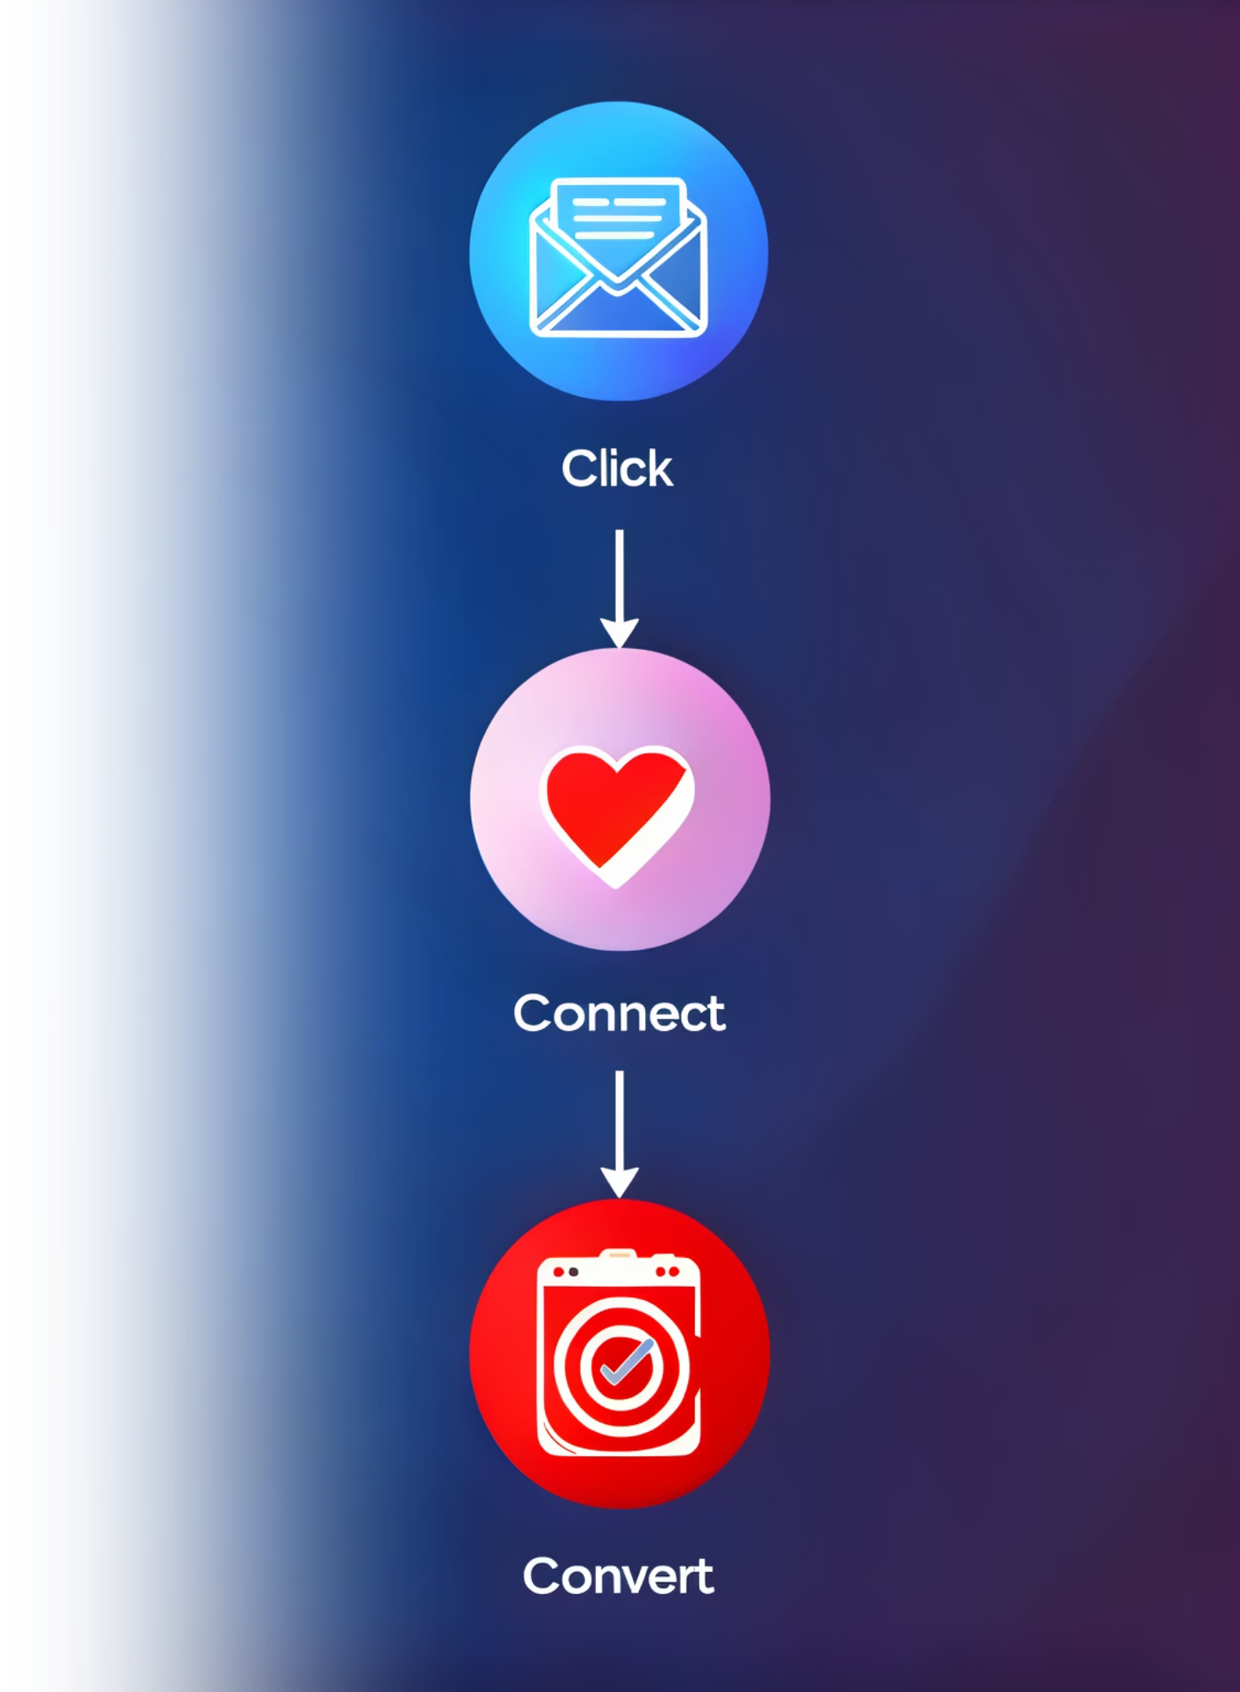

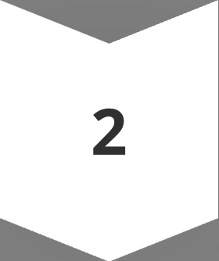

The Click, Connect, Convert Framework
Success in 2026 email marketing requires mastering three distinct hurdles. Each represents a different challenge your message must overcome to drive results.
Click
The technical hurdle. Getting past filters and earning the initial open.
Connect
The emotional hurdle. Building a relationship through relevance.
Convert
The economic hurdle. Moving the user from inbox to action.

Slide 4

CLICK: Beating the Bot
2026 mail servers are ruthless gatekeepers.
If your technical foundation isn't solid, you're invisible before you even start.
Here's what you need to know about deliverability.
The Technical Handshake
Engagement Signals
DMARC, SPF, and DKIM records are your email's "ID card." Without proper authentication, mail servers won't trust you. This is non-negotiable in 2026.
AI filters watch how users interact with your emails. If 50 people delete your message without opening it, your next 500 emails go straight to spam. Every send affects your reputation.

Slide 5
Establishing Your Email ID: SPF, DKIM, DMARC
In 2026, email authentication is non-negotiable. Major providers strictly enforce these protocols to prevent spoofing and ensure deliverability. Setting up your "ID card" involves adding specific TXT records to your domain's DNS settings. This ONLY applies to those who control their own DNS settings: purchased from GoDaddy or the like.
1
2
3
SPF (Sender Policy Framework)
DKIM (DomainKeys Identified Mail)
DMARC (Message Authentication, Reporting, and Conformance)
SPF lists the IP addresses and services authorized to send email for your domain, ensuring only approved sources can send on your behalf.
DKIM adds a cryptographic signature to your emails, verifying that the message hasn't been altered in transit and truly originated from your domain.
DMARC tells receiving servers how to handle emails that fail SPF or DKIM checks and requests reports on authentication results, giving you visibility into email delivery.
How to: Create a TXT record for your root domain (e.g., '@').
Example: v=spf1 include:_spf.google.com ~all (adjust for your email provider).
Rule: Only one SPF record per domain; combine multiple services into one.
How to: Generate a public/private key pair via your email provider's admin console.
Action: Copy the public key and add it as a TXT record in your DNS. Host name often looks like google._domainkey.
How to: Create a TXT record with the Host/Name _dmarc.
Example: v=DMARC1; p=none; rua=mailto:dmarc@yourdomain.com.
Strategy: Start with p=none (monitoring) then upgrade to p=quarantine or p=reject.

Slide 6
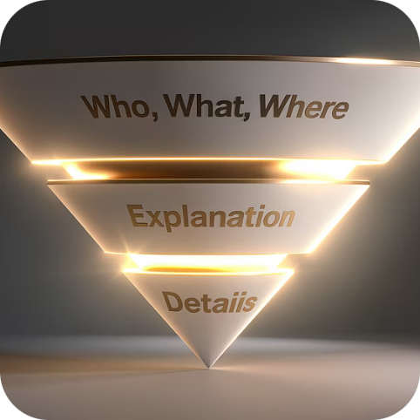

Writing for the AI Summarizer
The Inverted Pyramid
The Human Hook
Put your most important "Who, What, Where" in the first 2 sentences. This ensures the AI-generated preview accurately reflects your value proposition. Bury the lead, and you lose the reader.
If everyone uses AI to write "professional" subject lines, a handwritten-style approach like "quick question for [Name]" often performs better. Pattern interrupts or cut through the noise.

Slide 7
AI TOOLS
Subject Line Optimization
Predictive Analytics
3x
Use AI to predict which subject lines will work before you send. Modern email platforms analyze millions of data points to forecast open rates with surprising accuracy.
Inbox Volume
Average increase since 2024
Test multiple variations against your specific audience. What works for a B2B tech company won't work for a local bakery. Let the data guide your decisions, not assumptions.
47%
Open Rate Boost
With AI-optimized subject lines

Slide 8

CONNECT: The Death of the General List
The "monthly newsletter" is too broad for 2026. People want "My Interests Newsletter," not a one-size-fits-all blast.
Segmentation is no longer optional—it's the baseline expectation.
Zero-Party Data
Dynamic Content Blocks
Use your email to ask questions directly. "Are you interested in B2B networking or B2C marketing?" Use the answer to tag subscribers automatically and deliver relevant content.
One email template can show different images and text to different people. A retail member sees "Commercial Insurance" tips; a stay-at-home parent sees "Community Event" news.

Slide 9
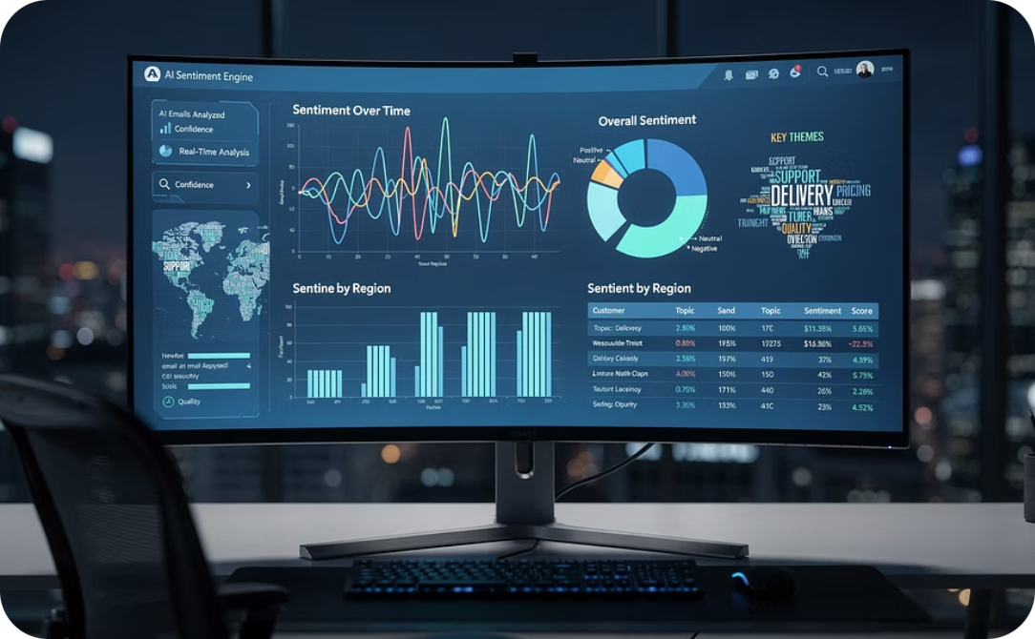

Hyper-Personalization with AI
Sentiment Analysis
Predictive Send-Time
Use AI to scan your replies. If a member responds with a frustrated tone, AI can flag that for a human to call them immediately. Turn potential problems into relationship-building opportunities.
"Tuesday at 10 AM" is a myth. AI now tracks when Individual A usually opens their mail—maybe 11 PM after the kids are in bed—and delivers it then. Timing is personal.

Slide 10

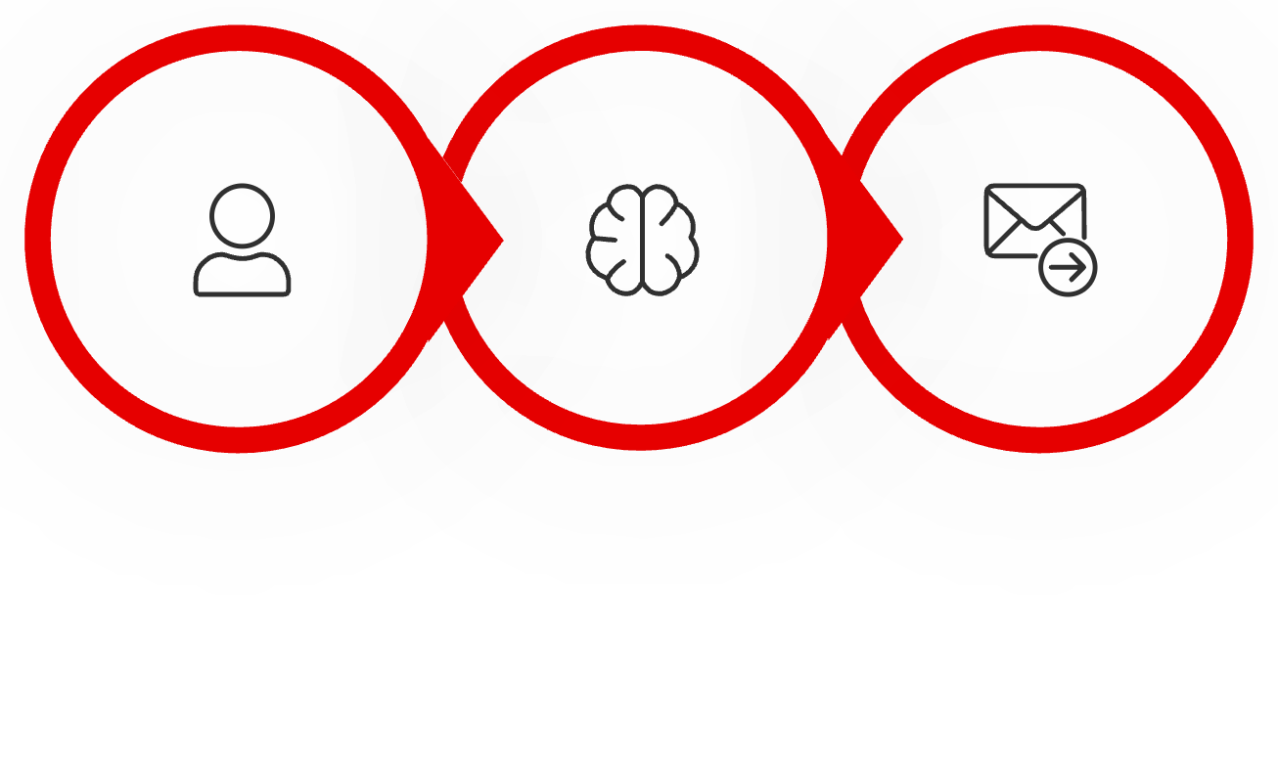



AUTOMATION
CONVERT: Agentic Workflows
Move beyond the basic welcome series toward true lifecycle marketing.
AI-powered workflows respond to user behavior in real-time, creating personalized journeys at scale.
User Action
AI Analysis
Personalized Follow-Up
If a member hasn't clicked a link in 90 days, AI triggers a "Win-Back" sequence with a special offer or survey. If a user clicks about a "Business Grant" but doesn't download the application, an automated nudge follows up 24 hours later with helpful tips.

Slide 11


The Human + AI Balance
The 80/20 Rule
Case Study: Local Bakery Success
Let AI do 80% of the heavy lifting—data sorting, first drafts, scheduling, analysis. But keep 20% for human "soul." This is where authenticity lives.
A local bakery used AI to segment their list into "Sourdough Lovers" vs. "Cupcake Fans." By sending targeted offers instead of one general menu, they saw a 30% increase in weekend foot traffic.
AI is great at logic but bad at local nuance. A human must ensure the email mentions local landmarks, weather, or recent Chamber events to prove a local human wrote it. This authenticity builds trust that no algorithm can replicate.

Slide 12
Your Checklist: Starting Today
While social media algorithms change constantly, you own your email list. It remains the most stable asset in your digital portfolio. Here's how to start leveraging AI for better results immediately.
01
02
03
Clean the House
Pick One AI Win
Audit First Impressions
Remove any subscriber who hasn't opened an email or visited your establishment in 6 months . This improves deliverability and ensures you're measuring real engagement.
Start using an AI subject line tester like those built into Mailchimp or Constant Contact. Small improvements compound quickly. Track your open rates.
Sign up for your own newsletter today. Is the welcome email helpful, or is it a robotic receipt? Do you have interesting ideas as hooks in the subject? Fix what you find.

Slide 13




The ROI Reality: Respect the Inbox
The question isn't whether to use AI in your email marketing—it's how to use it strategically.
AI won't make your emails look like spam if you use it to generate relevance, not just volume.
42:1
30%
80%
Email ROI
Engagement Lift
Time Saved
Average return on investment
With AI-powered segmentation
Through smart automation
Master the Click, Connect, Convert framework. Use AI as your assistant, not your replacement.
Remember: in 2026, the inbox belongs to those who respect it.

